Slide 1
Team 'Pneuma'
MBA DSA (2021-23) KJSIM, Mumbai

Slide 2
1. Recipe Sentiments from reviews
Used VADER is a tool used for sentiment analysis
It shows positive, negative, neutral and compound score for recipe reviews
Why we used compound score?
Used Min-Max scaling for rating from 1 to 5

Slide 3
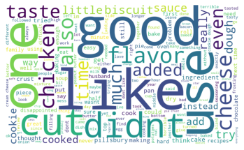
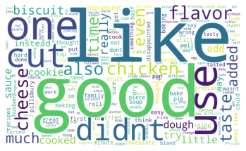
2. Major Themes
Positive
Negative

Slide 4
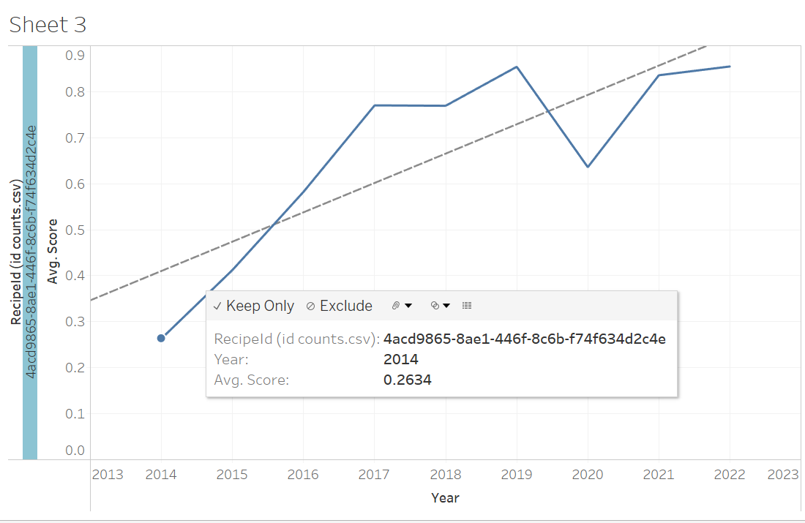
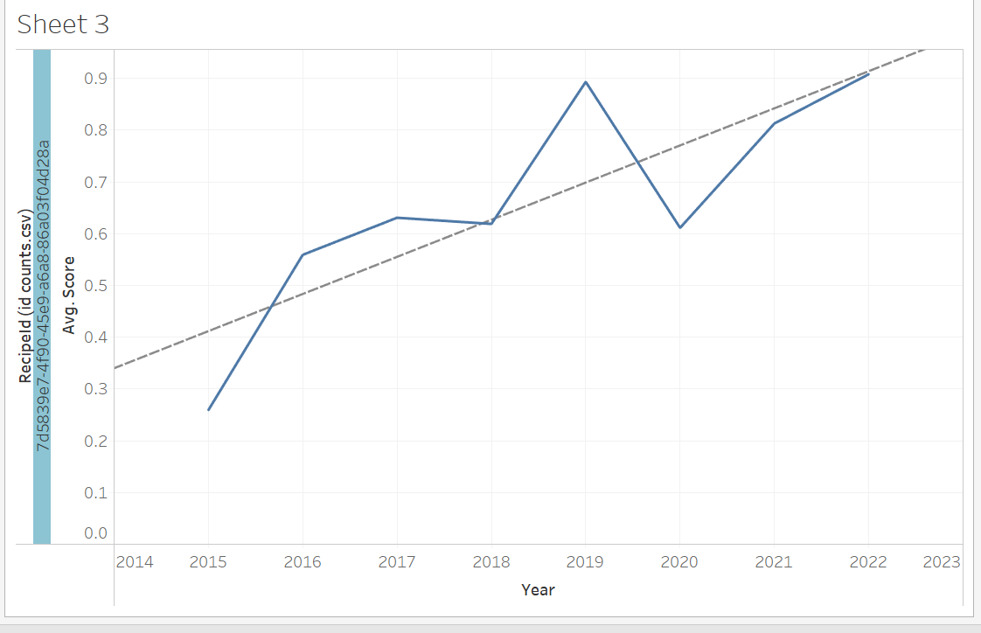
Slow-Cooker Maple-Brown Sugar Ham
3. Review trends changed overtime
5-Ingredient Salted Caramel Crumble Bars
As seen the sentiment score of this recipe has shown the upward trend starting from 0.26 in 2014 to 0.85 in 2022
Even this recipe has seen the upward trend in Sentiment score, starting from 0.26 in 2014 to 0.9 in 2022

Slide 5
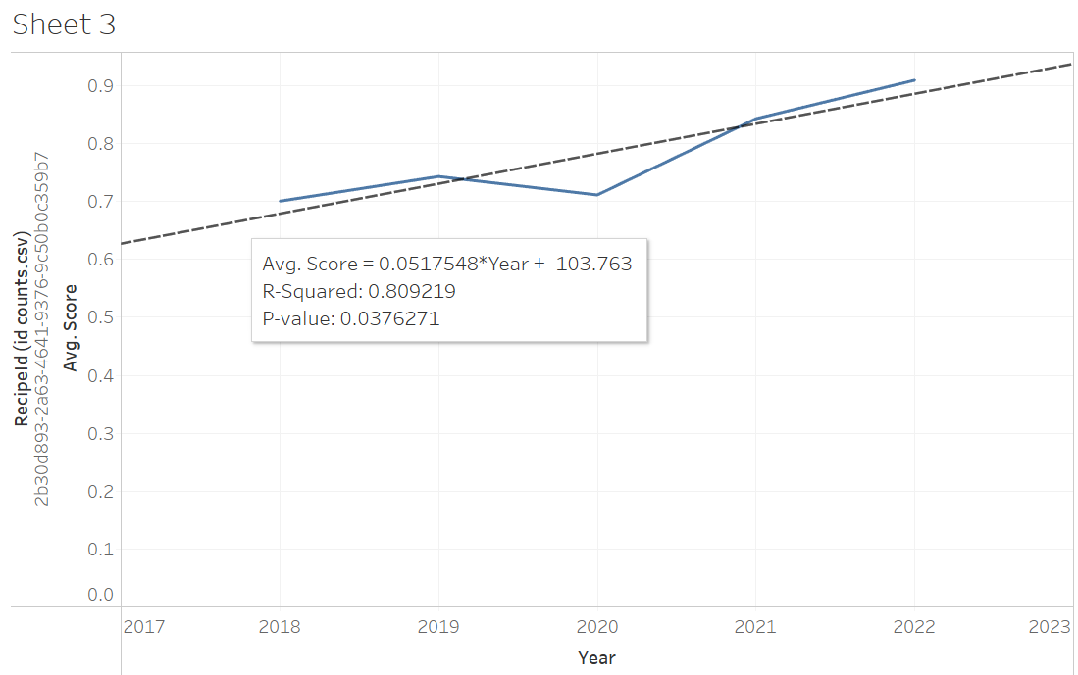
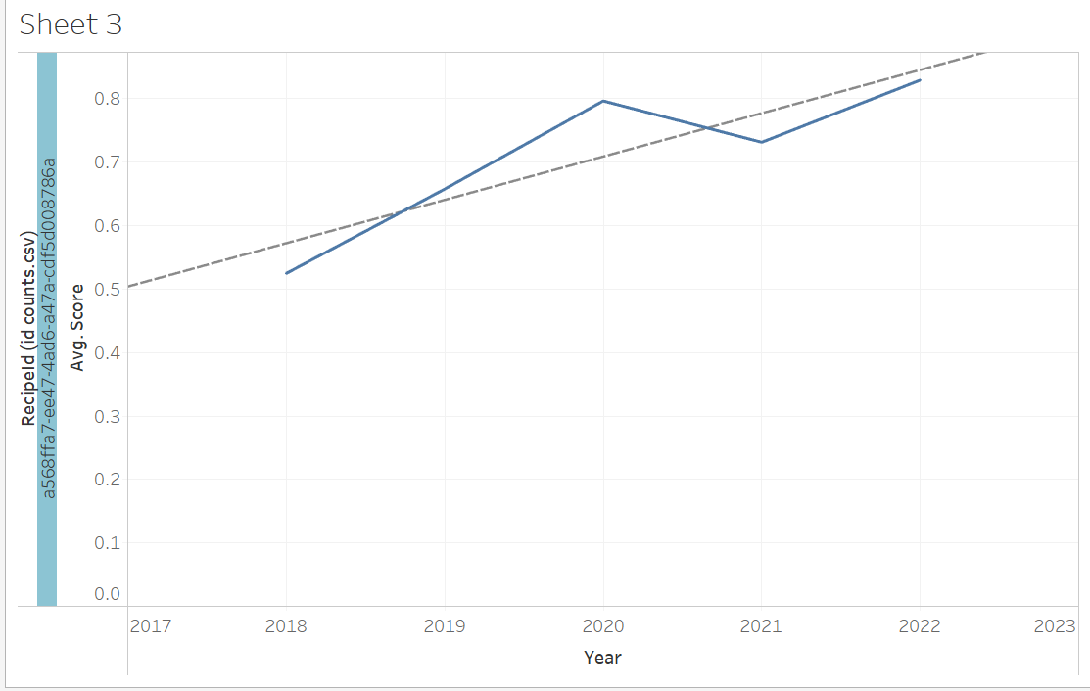
Blueberry-Lemon Cinnamon Roll Breakfast Bake
3. Review trends changed overtime
Crispy Caesar Chicken
Slight upward trend over the 5 years from 2018 to 2022
Upward trend from 2018 to 2022

Slide 6
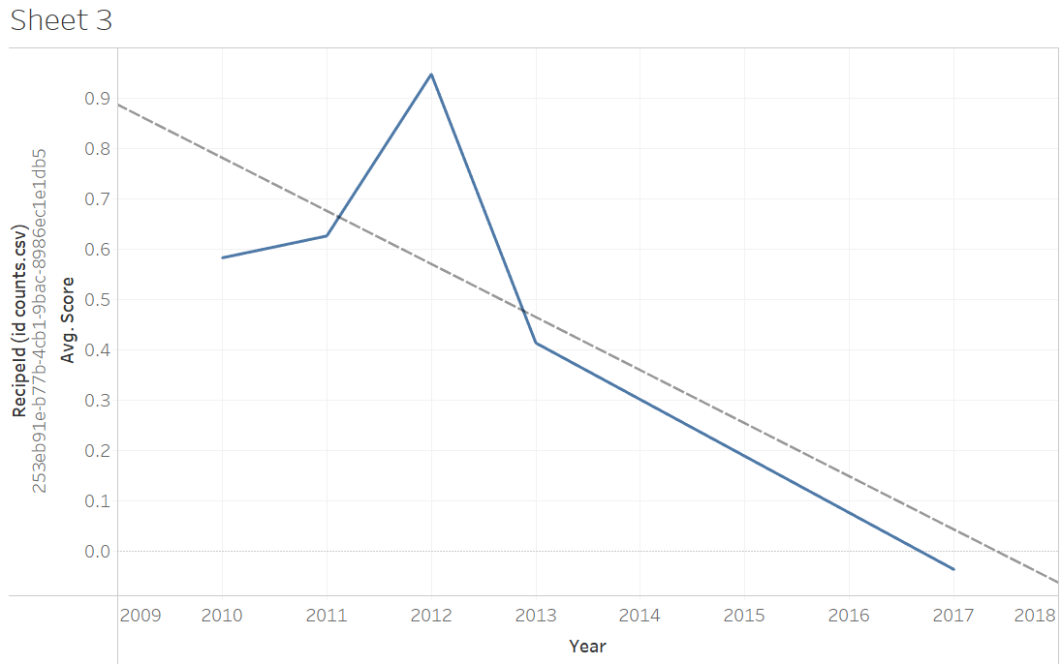
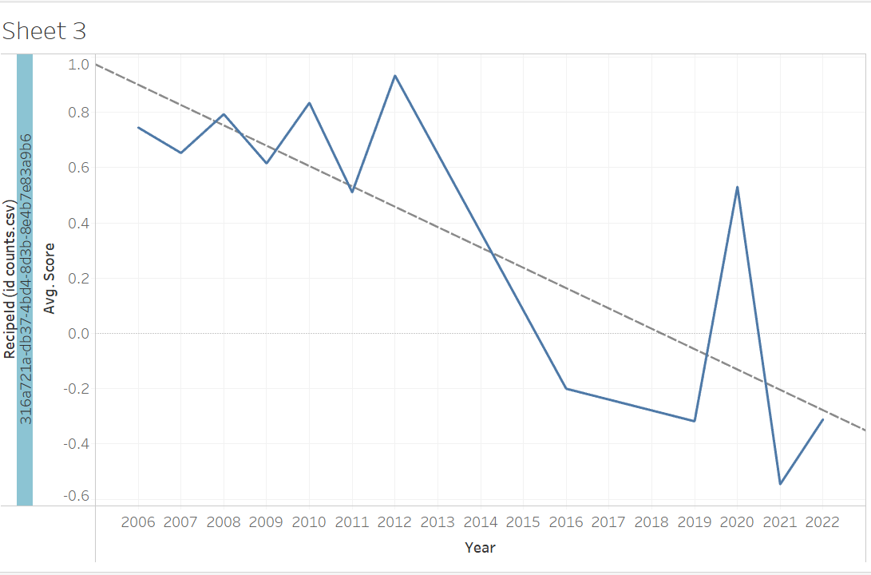
Mile-High Peanut Butter-Brownie Pie
3. Review trends changed overtime
Cinnamon-Apple Crostata
Constant drop in sentiment score over the time with negative score in the last year
Huge dip from high sentiment score to negative score in the last year

Slide 7
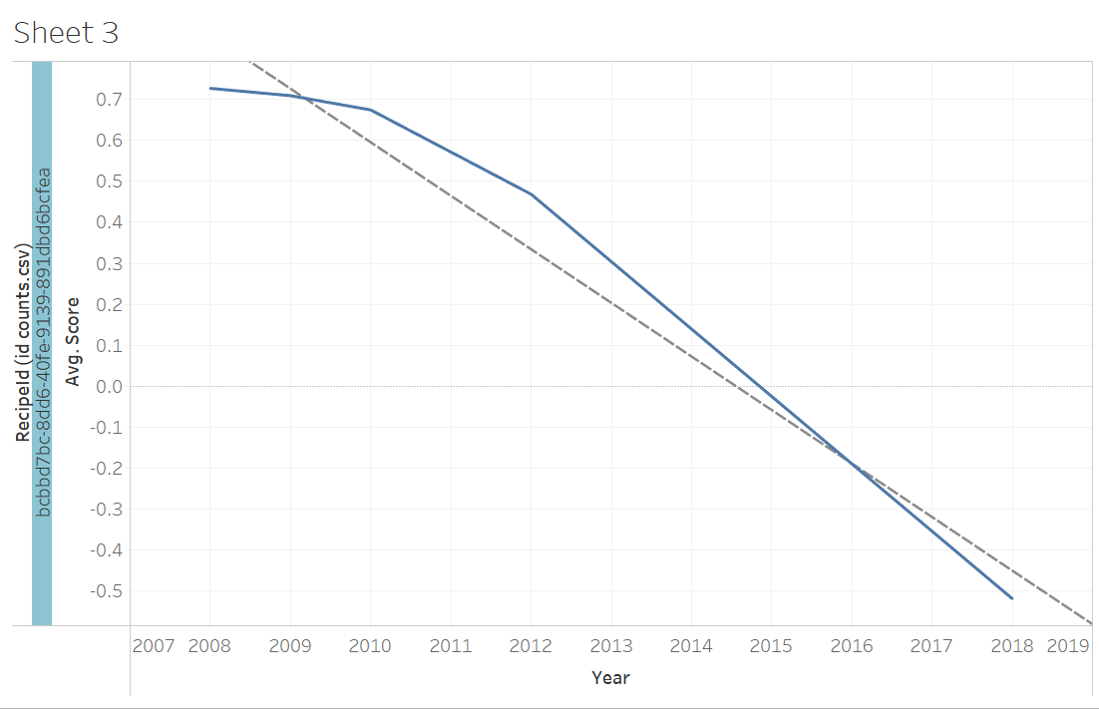
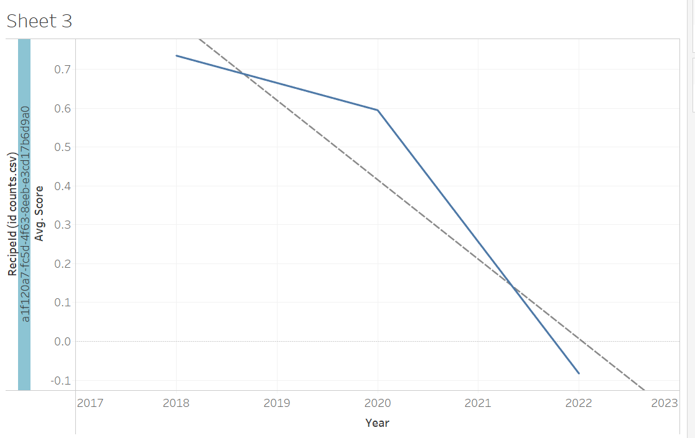
Peach Oatmeal Crisp
3. Review trends changed overtime
Pineapple-Black Bean Enchiladas
Continuous drop in the sentiment score over the period of 10 years
A slight drop until 2020 and again huge decline until the last year

Slide 8
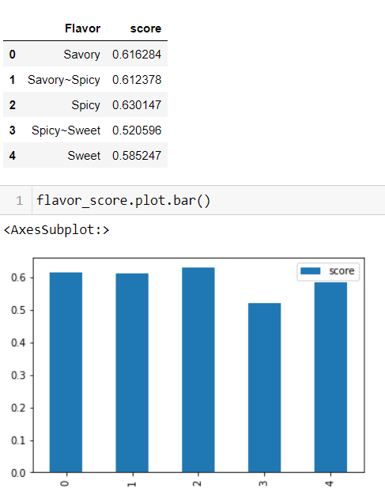
4. Flavor type significance

Slide 9
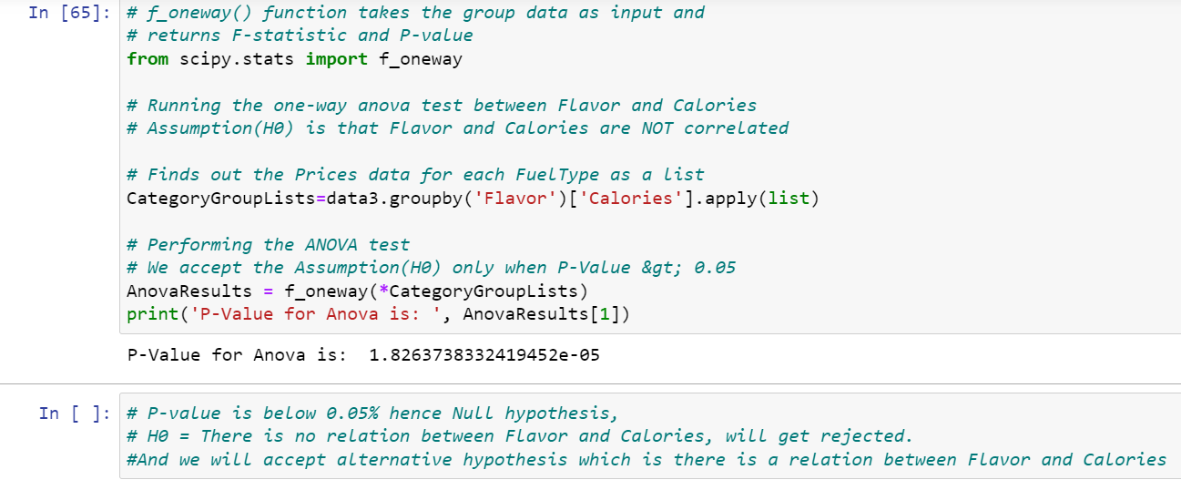
5. Flavor type significance

